Slide 1
Building Electrification Committee
Battery Storage - The Basics - Part 2
Mike Winka
mwinka@comcast.net – 609-778-8717

Slide 2
Best advise – hire a reliable professional
My goal is:
To help you be armed with good information
But Im caution about residential battery storage
Disclaimer: all calculations are estimates for examples

Slide 3
Some basic terms
Kilowatt-hour (kW-h) - Amount of electric energy (Joule)
Kilowatt (kW) – Amount of power energy/time – kW-h/h) (Joules/sec = watt)
Capacity or installed capacity
1000 watts (w) = 1 kilowatt (kW)
1000 kW = 1 megawatt (MW)
If someone used 10 – 100 w lightbulbs for one hour
They would use 1 kWh of electric energy at $0.19/kWh
A 14 W LED used for 7.5 hours = 1 kWh or 71 14 w - 1 hr

Slide 4
The electric rate
Storage helps in a TOU rate or Demand Charge
Or if you need reliability- grid outages
Residential electric customers pay one fix energy rate set as cents per kWh ($/kWh)
Commercial customers pay two rates
The energy charge $ per kWh
The demand charge $ per kW which is based on the customers highest electricity usage
Net metering tariff only applies to the
energy rate $/kWh not the demand charge $/kW
Battery storage can reduce your demand charge

Slide 5
First things First –
You will need
Building construction approval
Especially the local fire code –
You may need depending on configuration
Utility interconnection approval
BPU Storage Incentive if and when approved
Reach out to the zoning/code office
If and when
reach out to BPU for storage incentives
https://www.njcleanenergy.com/storage
There is a 30% federal ITC for residential storage (may have to account for state rebates)
Does not require grid connection does not have to be part of a solar system

Slide 6
First things First
The system must be installed by a licensed electrician
https://www.njconsumeraffairs.gov/elec/Pages/default.aspx
The system must be installed by a licensed Home Improvement Contractor (HIC)
https://www.njconsumeraffairs.gov/hic/Pages/applications.aspx

Slide 7
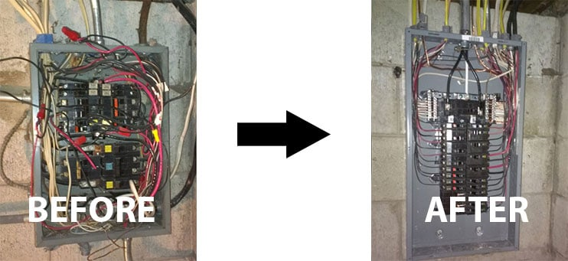
First things First
You may need to upgrade your electric panel
100 Amps
200 or 400 Amps
Costs range from $1,500 to $3,000 + depending on site conditions
If you have an underground service it could cost upwards of $10,000
There is a 30% federal tax credit 1/1/23 to 12/31/32
Electric Utility – make ready incentives

Slide 8
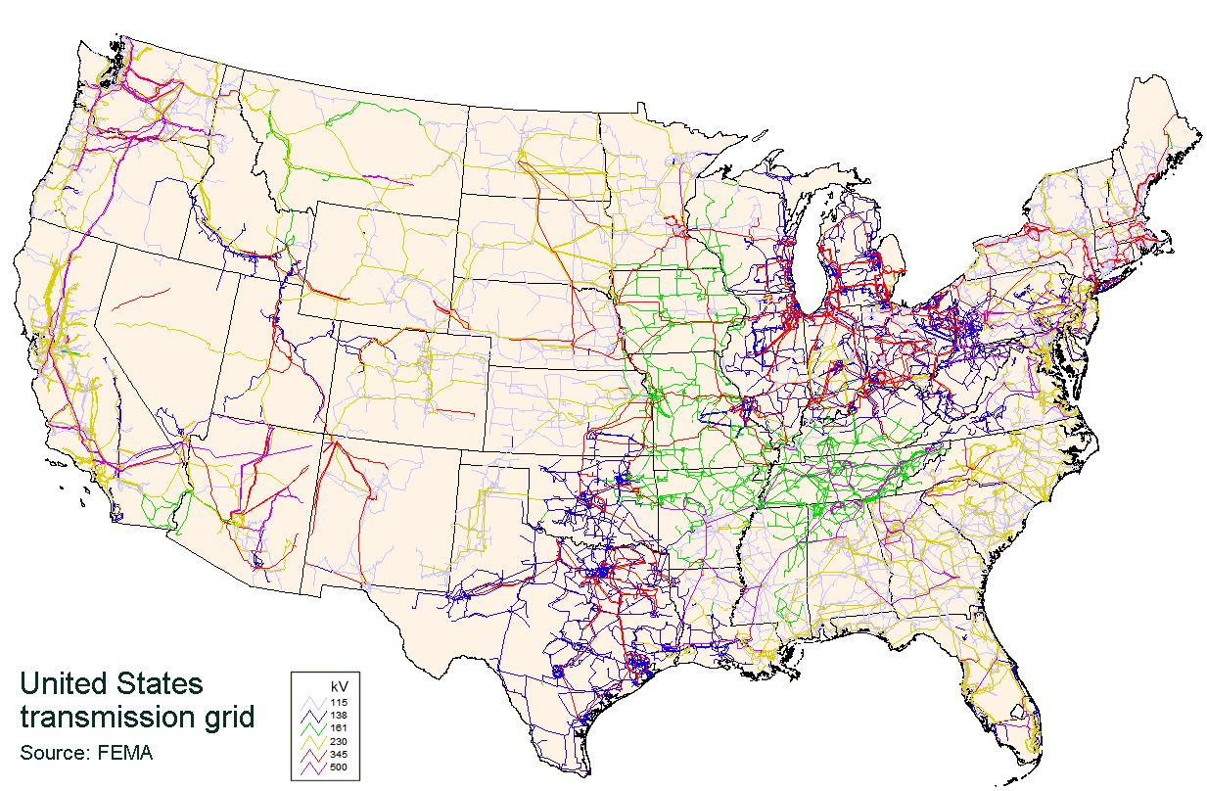
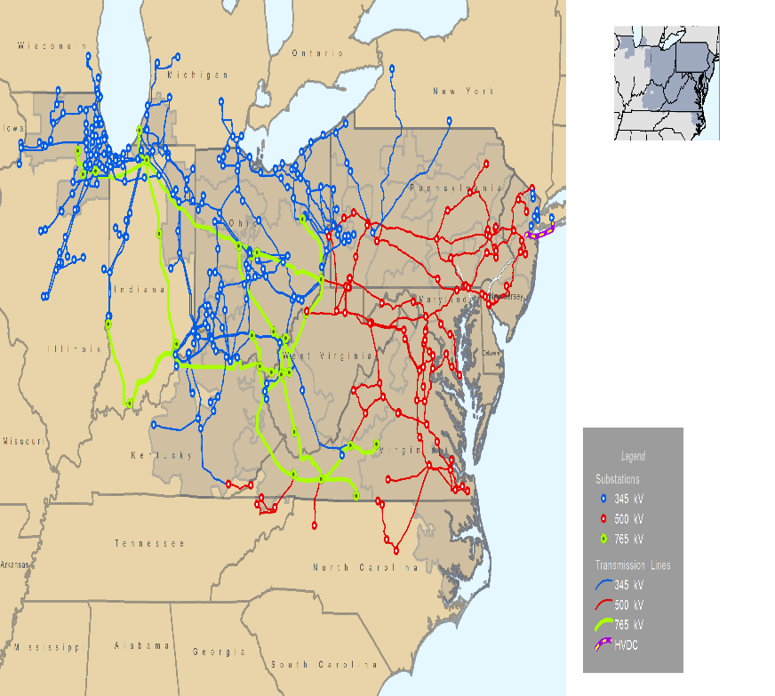

200,000 miles of transmission lines and 5.5 million miles of distribution wires

Slide 9
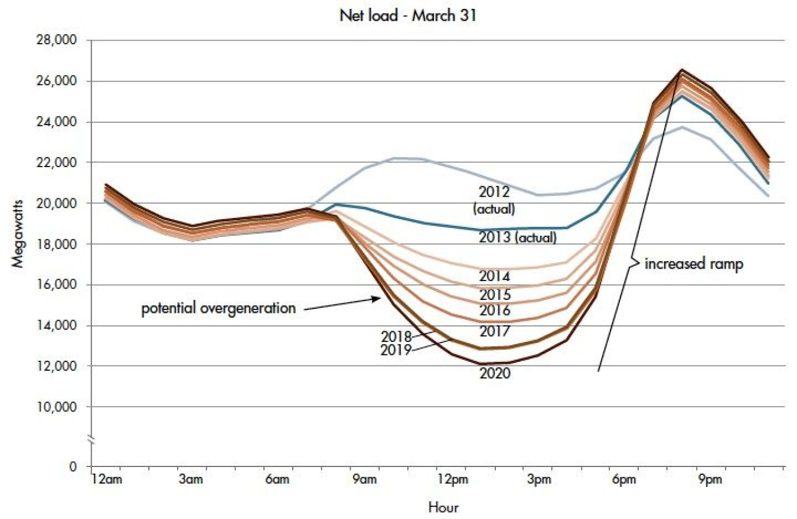
California Duck Curve
The grid needs to go from
14,000 MW to 25,000 MW in
3 hours
The grid sees solar as reduced load
Drops from 19,000 MW to 12,000 MW

Slide 10
California Duck Curve

Slide 11
Adding Storage as part of a New or Existing Solar System
What is Storage – A way to capture energy for later use
Mainly for electricity since oil coal and natural gas are already stored energy
Storage adds flexibility to the grid – they can add that energy when needed
Storage can make the grid more reliable and resilient
But at what size and what cost ?
Many ways to store energy
Pump Hydro/Compressed air – the current majority 70%
Thermal Storage – new more distributed < 1%
Capacitor
Flywheels
Batteries Li ion, Pb acid, Ni-Cd, M+ hydride, Zn air, Alkaline flow batteries 29%
Li Ni Mn Co and Li Fe PO4 wet vs dry cells vs solid state
Basically a metal + and an electrolyte –
NJ Storage Goals 600 MW by 2021 and 2000 MW by 2030
Yards Creek 400 MW pump storage

Slide 12
Storage is more complex than solar
Solar is essentially plug and play
Storage – especially battery storage requires routine
monitoring and maintenance to operate properly
If you are good at routine maintenance
battery may be OK for you
If not you need to think about how
to get the system serviced

Slide 13
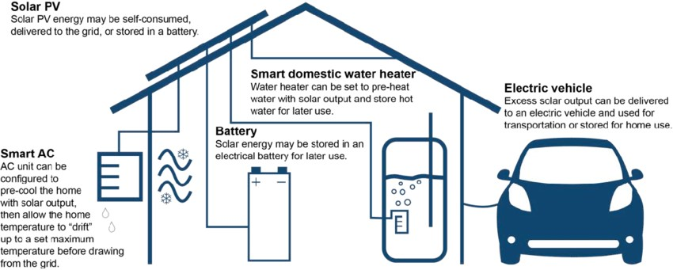
https://reopt.nrel.gov/projects/case-study-residential-storage.html

Slide 14
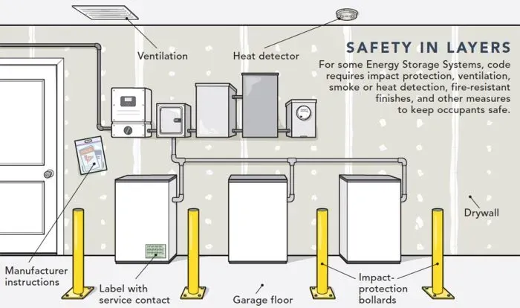
NJ UCC Fire Subcode Chapter 12
Section 1207 Electrical Energy Storage Systems (ESS)

Slide 15
TABLE 1207.1.1
ENERGY STORAGE SYSTEM (ESS) THRESHOLD QUANTITIES
For residential systems
TECHNOLOGY | ENERGY CAPACITYª
Capacitor ESS | 3 kWh
Flow batteries | 20 kWh
Lead-acid batteries, all types | 70 kWh^{c}
Lithium-ion batteries | 20 kWh
Nickel metal hydride (Ni-MH) | 70 kWh
Nickel-cadmium batteries (Ni-Cd) | 70 kWh
Other battery technologies | 10 kWh
Other electrochemical ESS technologies | 3 kWh
You can install more than the threshold
but that puts you in a higher requirement category

Slide 16
Battery Terms
Energy – kWh
Power - kW
Ratio of E/P > 2
Depth of Discharge – 100% 80-90% > 40%
Round trip efficiency (charging – discharging) – losses > 80%
Duration – 2 hours, 4 hours, 8 hours (kw-hrs / kw = hours)
Battery Life 8 – 10 years 6,000 - 10,000 cycles > 70% (15+ years)
Watts, Volts and Amp and Amp-hours
AC or DC coupling

Slide 17
Battery Purpose
Do you want to extend your solar electric generation by day
Do you want to run your home in an emergency – how much?
Do you just want the newest technology
Vehicle to load or Vehicle to Grid - V2L or V2G
You may not be able to run your whole house on battery storage
What is the appliance/equipment starting power - surge power
But you can run critical equipment

Slide 18
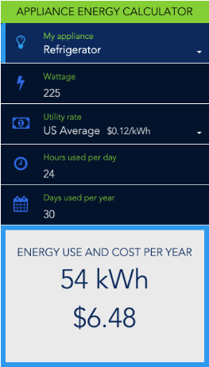
Battery Purpose
What are the watts = volts x amps
Watts (120 V x 20 A = 2,400 watts or 2.4 kW)
5 kw – 10 kWh of usable energy
you can run 5 kW for 2 hours or 1 kW for 10 hours
What about amp-hours? (Ahr x volts = kWh)
3,300 w (3.3 kW) heat pump – 3 hours
300 w (0.3 kW) TV – 33 hours
200 w frig – 50 hours
5 – 20 w light bulbs – 100 hours
25 w phone charger – 400 hours
6 w wi-fi router – 1,600 hours
Estimating Appliance and Home Electronic Energy Use
Energy Save
https://www.energy.gov/energysaver/estimating-appliance-and-home-electronic-energy-use

Slide 19
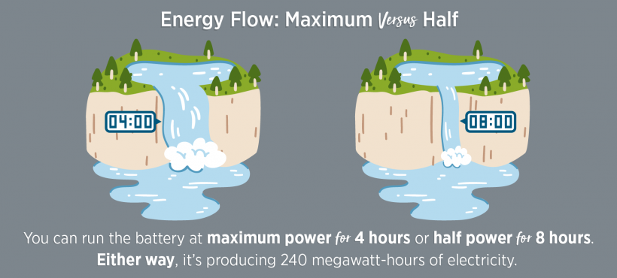
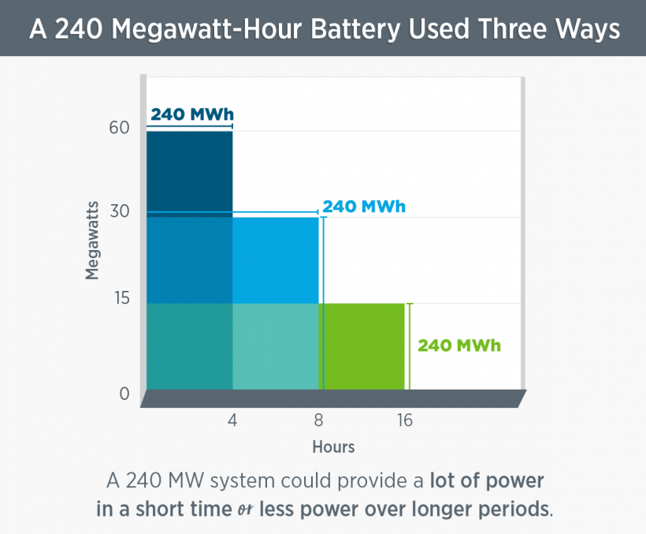

Slide 20
NREL U.S. Solar Photovoltaic System and Energy Storage Cost - Benchmark: Q1 2020
Added $10K to PV system cost
for 1/4 - 1/3 of the PV average output
Double the PV system cost for
the PV average daily output
Assuming a 7 kW residential solar at $3/watt installed - $21,000 before ITC
Residential Battery storage systems can get a 30% federal ITC greater than 3 kWh and for standalone backup batteries
but currently no NJ State Clean Energy Program incentive
https://www.nrel.gov/docs/fy21osti/77324.pdf https://atb.nrel.gov/electricity/2023/residential_battery_storage

Slide 21
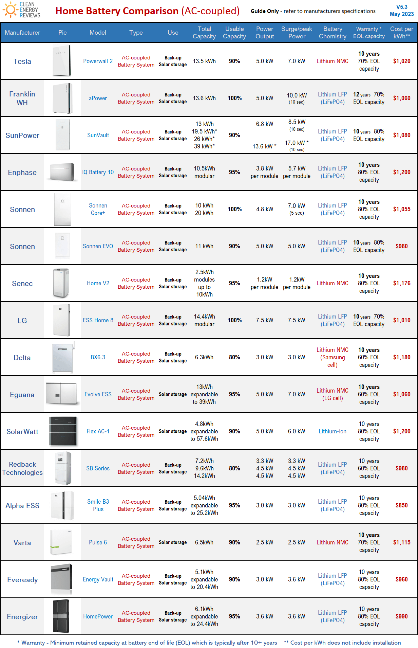
Do you want a integrated system or custom
https://www.cleanenergyreviews.info/battery-storage-comparison-chart
Ht https://www.solarreviews.com/solar-battery-reviews
https://news.energysage.com/best-solar-batteries/

Slide 22
Do you want a integrated system or custom
https://www.cleanenergyreviews.info/battery-storage-comparison-chart
Ht https://www.solarreviews.com/solar-battery-reviews
https://news.energysage.com/best-solar-batteries/
https://www.energysage.com/energy-storage/how-much-do-batteries-cost/
Battery Company | Price Per KWh* | Typical Battery Size** | Total Installed Cost After The Federal Tax Credit
Enphase | $1,344/kWh | 10 kWh | $9,408
Tesla | $1,000/kWh | 13.5 kWh | $9,450
FranklinWH | $1,103/kWh | 13.6 kWh | $10,501
SolarEdge | $1,683/kWh | 9.7 kWh | $11,428
Panasonic | $1,111/kWh | 9 kWh | $6,999
EG4 | $1,049/kWh | 11.44 kWh | $8,400
SunPower | $1,304/kWh | 13 kWh | $11,866
Growatt | $1,289/kWh | 9 kWh | $8,121
Generac | $1,961/kWh | 9 kWh | $12,354
HomeGrid | $1,332/kWh | 9.6 kWh | $8,951
Cost of top 10 battery brands
*The median price per kWh of the 10 most quoted batteries on EnergySage in the first half of 2024.
**The median usable capacity of the 10 most quoted batteries on EnergySage in the second half of 2024.

Slide 23
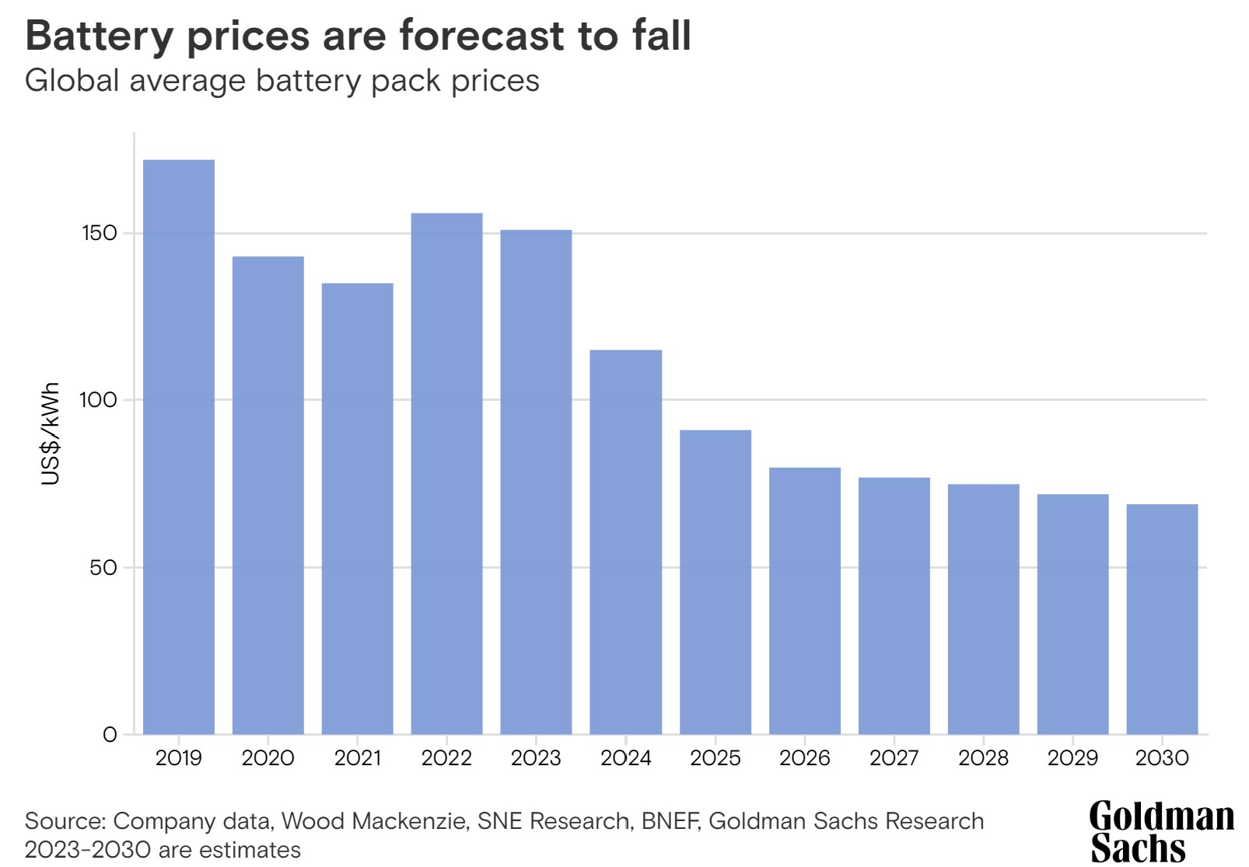

Slide 24
NREL U.S. Solar Photovoltaic System and Energy Storage Cost - Benchmark: Q1 2020
DC
DC
DC
DC
More efficient
Higher cost
Easier for net metering
Less efficient
More flexible
Issues with net metering
https://www.nrel.gov/docs/fy21osti/77324.pdf

Slide 25
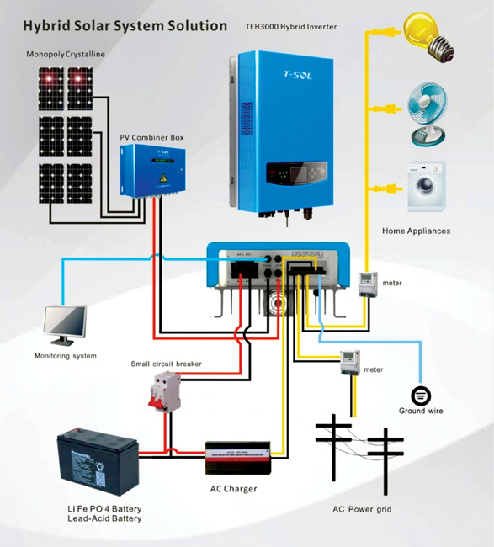
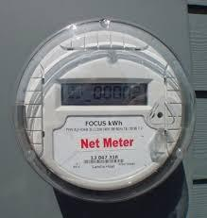

Slide 26
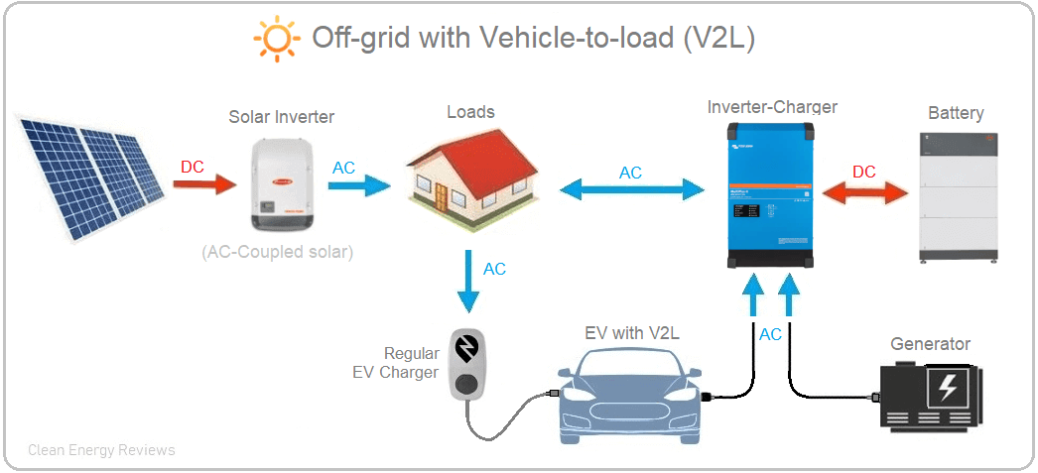
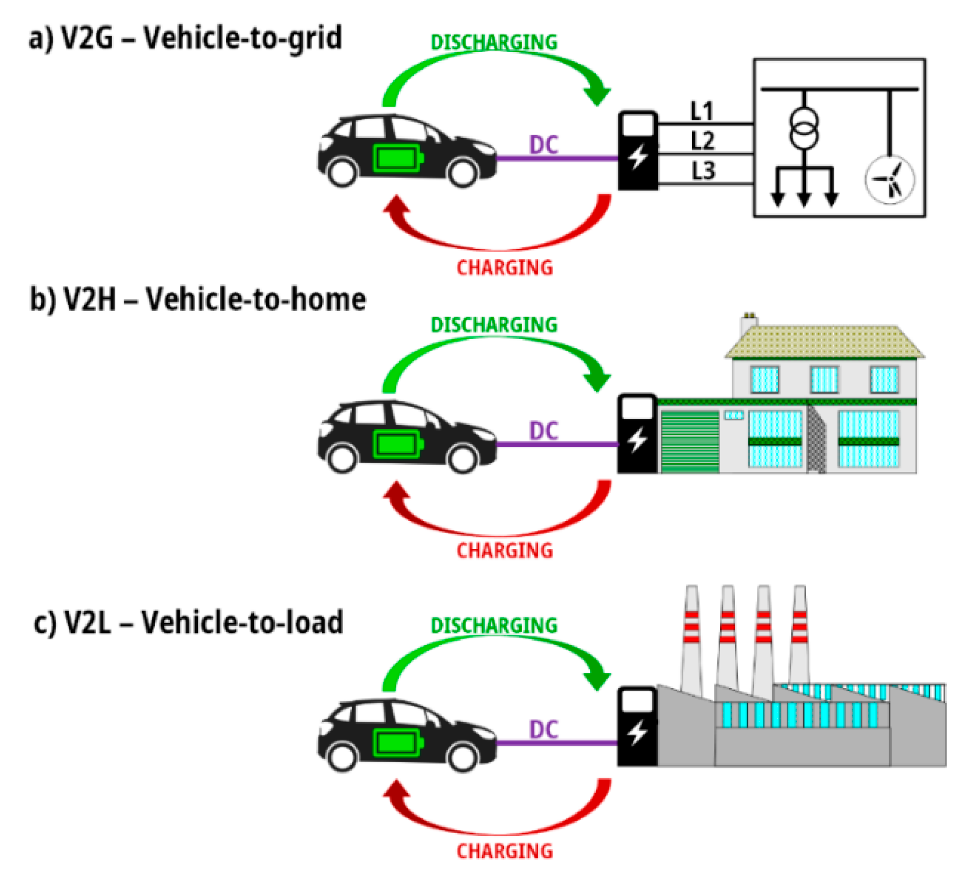
What is V2G or V2L or V2H or V2X V2L/V2H if operated as backup with a transfer switch
V2G ? TBD
https://www.cleanenergyreviews.info/blog/vehicle-to-load-v2l-explained#google_vignette
https://www.mdpi.com/1996-1073/14/12/3673

Slide 27
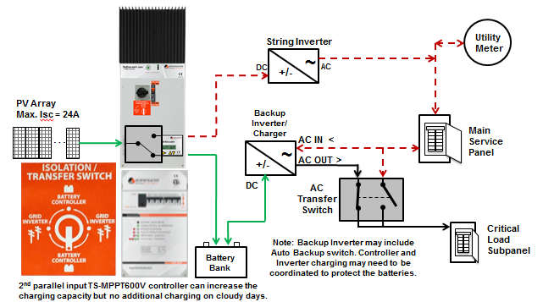
Using a direct DC transfer solution to better back-up solar
Example of a transfer switch during a grid outage
https://www.solarpowerworldonline.com/2016/03/using-a-direct-dc-transfer-solution-to-better-back-up-solar/
BPU Net metering and IX rules and Electric Utility Tariffs apply ?

Slide 28
Calculate your simple payback
Total Capital cost – Incentives
Total Revenues (avoided electricity and SREC)

Slide 29
Calculate your simple payback
From Solar 101 – Part 1
Calculate your cost (capital cost – incentives)
Example
7 kW X $3 per watt installed = $21,000
30% federal Investment tax credit ITC = $6,300 (after state rebates)
$14,700 is the net cost of the 7 kW solar PV system
after accounting for your ITC
$10,000 after accounting for the ITC
Total system cost $24,700
Tracking the Sun – LBL- NREL USDOE energy labs
https://emp.lbl.gov/tracking-the-sun

Slide 30
Calculate your simple payback
Calculate your annual revenues
Example 7kW solar and 10 kWh battery – 4 kW
From Solar 101 – Part 1
Avoided electricity generated
9,000 kWh per year
Annual value for NM/IX at $ 0.1988/kWh (per EIA)
= $1,789 per year
Solar Renewable Energy Credit (SREC) = 1 MWh or 1,000 kWh
SREC II generated = 9 per year
Successor Solar Incentive (SuSi) at $85 per MWh = $765
Total revenues = $1,789 + $756 = $2,545/year

Slide 31
Calculate your simple payback
Total Capital cost – Incentives
Total Revenues (avoided electricity and SREC)
Just the 7 kw Solar
$14,700 / $2,545/year = SPP
about 6 years or about 17% ROI (8 years – 12% ROI )
7 kW solar with 3 kW – 6 kWh Battery Storage (1/3 to 1/2 of load)
$24,700 / $2,545/year = SPP
about 10 years or about a 10% ROI
7 kW solar with 5 kW - 20 kWh Battery Storage (full load)
$30,100 / $2,545/year = SPP
about 12 years or about 8% ROI
7 kW solar with 5 kW - 20 kWh Battery Storage no ITC
$43,100 / $2,545/year = SPP
about 17 years or about 6% ROI
This could change if FERC, PJM and the states allow battery storage to
receive payment for providing resources to the grid

Slide 32
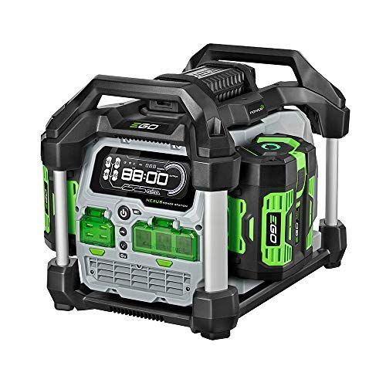

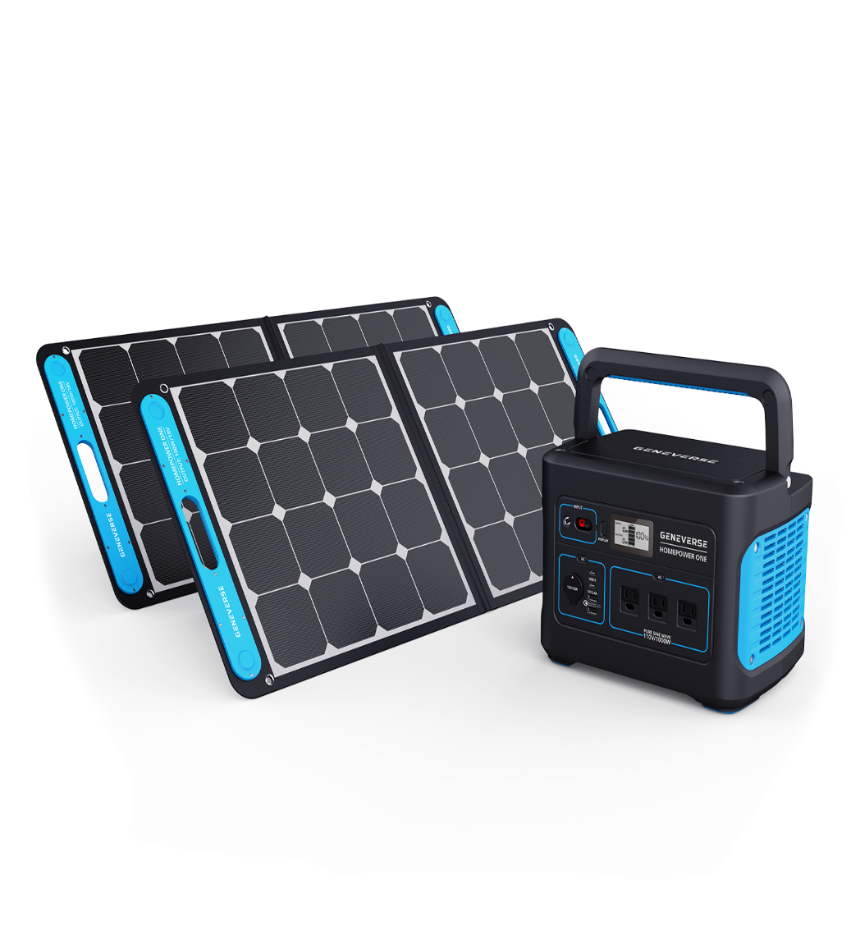
Battery – start small with a battery power pack

Slide 33
Questions ?

Slide 34
The EMP mitigation measures are not perfect
Need to know the issues to pull together a “real” plan
Solar – only generates electricity when the sun is shining – less in the winter, more in the summer
end of life issues – recycling/reuse
OSW – only generates electricity when the wind is blowing - more in the winter. less in the summer
end of life issues – recycling/reuse
Storage – expensive, impacts in mining, lower performance in cold weather,
end of life issues – recycling/reuse
EV – expensive, impacts in mining, impacts in disposal, lower performance in cold weather
Heat pumps – lower performance in cold weather, may need a backup in very cold weather
The Grid – needs to be expanded to manage double the load and inverter based
These mitigation technologies are good but not 100% and not for everyone today
The key is incremental – implement where it works and build up and out

Slide 35
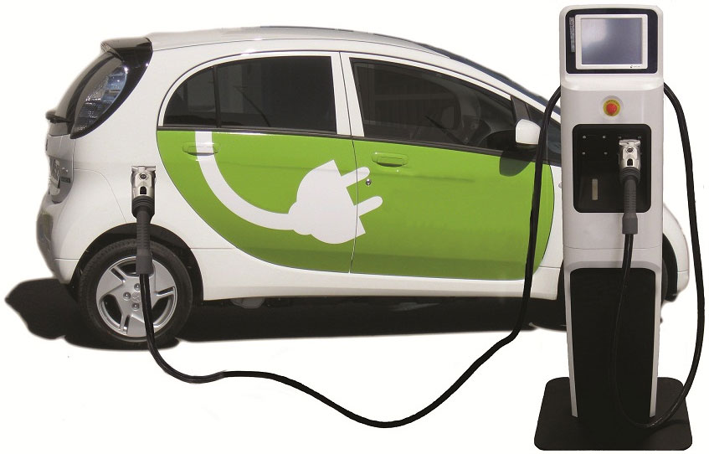
Transportation Sector - Going Electric
How to Change the Demand Curve for Oil and Gasoline
to Prevent Future Oil pipelines
Start slow and small and build into a movement
Used EV for under $20,000 (+ $2,000 - level 2 charger)
50 miles RT for 260 days (5 day work week)
An average ICE vehicle
520 gal/ yr - 60.3 MM Btus/yr -$1560/yr. ($3.00)
An average EV
3,900 kWh /yr - 13.3 MM Btu - $640/yr.($0.14)
4.5 times less energy – 2.4 times less cost
Savings $1,124/yr. avoiding 3.74 MT of CO2
3,900 kWh / year - 3.5 kilowatts (kW) of solar
@$3/watt SPP for EV and solar 15 yrs. (ROI 6.7%)
Avoiding 4.62 MT of CO2
Reducing both gasoline and natural gas
demand and emissions and storage solar electricity
MM Btu is a million Btus

Slide 36
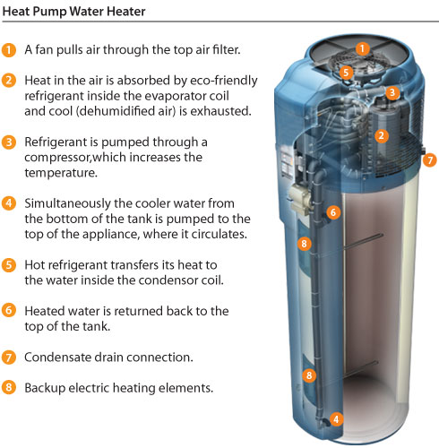
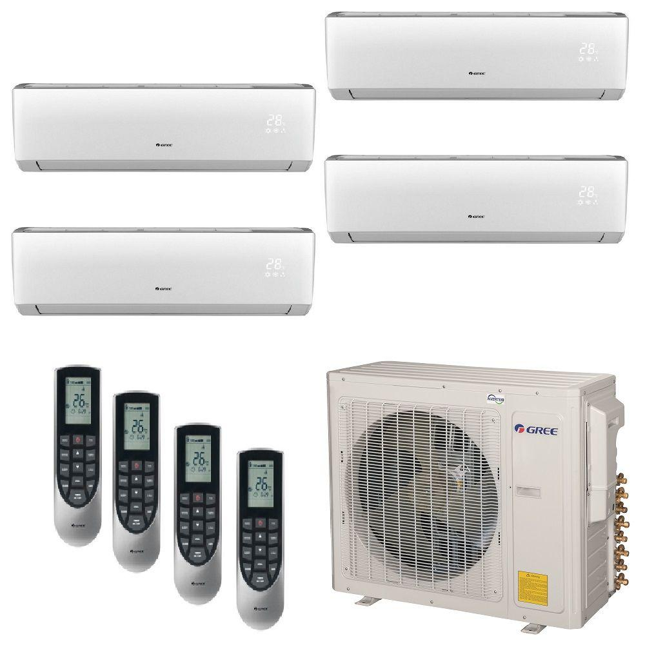
Building Sector - Going Electric
How to Change the Demand Curve for Natural Gas
to Prevent Future Natural gas pipelines
Start slow and small and build into a movement
GWH = $1,200
230 therm – 23 million Btus $320/yr emitting 2.3T
HPWH = $2,500
2,000 kWh 6.8 million Btus $330 /yr emitting 0.5T
3 times less energy - Avoiding 1.8 T of CO2
2,000 kWh /year = 1.5 kilowatts (kW) of solar
@ $3/W = $3,330
HPWH + solar = 10.5 years (ROI 9.5%)
Avoiding 2.3 T of CO2
Reducing natural gas demand in electric and heating sectors
A major advantage is you can store your solar electricity in the HPWH
30% federal tax credit plus $600 Utility EE incentive

Slide 37
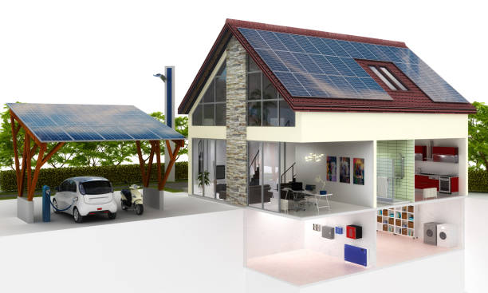
Can you electrify your home to light, heat, and cool your home and charge your EV’s powered by your own fuel by 2035 ?
What would it take?
Notes:
Residential customers have realized clear benefits as well…..

Slide 38
Princeton Adult School - Solar 101
Thank You
Michael Winka
energy translator
mwinka@comcast.net

